Slide 1


TY Coding
Lesson 02 – Variables and Datatypes

Slide 2


LESSON 1 RECAP
IN THE FIRST LESSON WE LEARNED ABOUT:
Characters: which are any single thing we can output using our keyboard.
Strings: which are groups of 2 or more characters.
Quotation marks: that characters and strings need to be surrounded by quotation marks.
Functions: which are reusable pieces of code that do a task for us.
How to use the print function to output to our screens: print()

Slide 3
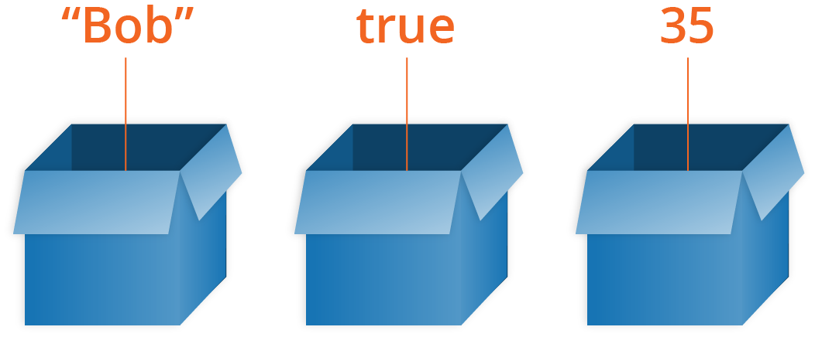
PART 1 - VARIABLES
A Variable can be considered a box that we can place any data into

Slide 4

VARIABLES
Data type | Short-hand name | Description of data type | Example of data type
Integer number | int | An int is a whole number | 10
Floating point number | float | A float is a decimal number | 3.14
Character | char | A single keyboard digit | "A"
String | str | A sentence or collection of characters | "My favourite food is pizza"
Boolean | bool | Holds the value of either True or False | True
What is a variable?
A variable is a container that we can create in our program to store a value.
What values can a variable store?
In python, there are different types of values which we call data types.
A variable can be used to store any of these data types.

Slide 5
VARIABLES
Creating a variable
To create a variable, we type (or "declare") the name of the variable, and then we assign a value to the variable.
In python, the assignment operator is "=" which you know as the equals sign.
Let's suppose we want to create one variable to store a string with our favourite animal in it and another variable to store our birth year.
Which in our code editor, looks like:
My_favourite_animal = "hippopotamus"
My_birth_year = 2004
Variable name | Assignment operator | value
my_favourite_animal | = | "hippopotamus"
my_birth_year | = | 2004

Slide 6
VARIABLES
General RULES FOR NAMING YOUR VARIABLES
Can contain only numbers, letters and underscores.
Must not start with a number (but it may contain one).
My_income_1 is okay.
1_my_income is not okay.
No spaces in the variable name.
No special characters (such as ‘@’).
Must not be a python keyword (e.G. true, none, false, break).
Don't make your variable names too long.
The python naming convention is to use all lowercase letters, joined by underscores:
E.G. my_variable, my_age, house_width, number_of_pets

Slide 7

VARIABLES
EXAMPLES OF VARIABLES:
name = "john“ age = 15 latest_grade = "b“ grade_point_average = 3.8 is_a_student = true
The variable: name contains the string value: "john"
The variable: age contains the integer value: 15
The variable: latest_grade contains the character value: "b"
The variable: grade_point_average contains the float value: 3.8
The variable: is_a_student contains the boolean value: true
*Nb* you will notice that you do not need "quotation marks" when assigning int, float & boolean values!

Slide 8
VARIABLES
Variables and the print function
If you remember from last week, we used the print() function to print out strings. We can also use the print() function to print out variables! And the good news is that it works pretty much the same way.
Let's say we have 2 variables that contain our pets name and what year we are in, in school.
pets_name = "bob ross" remember we must use "quotation marks" for a string.
pchool_year = 4 recall there are no need for quotation marks for an int, float or bool value.
So, let's print these variables using the print function:
print(pets_name) we can simply place the variables
print(school_year) inside the print function to output them.
Will give the output:
Bob ross
4

Slide 9

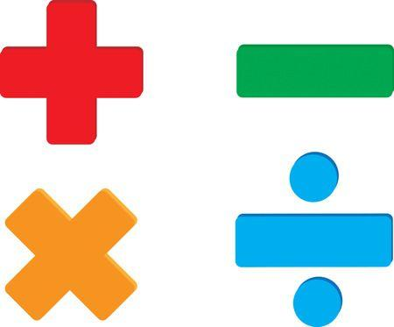
PART 2 - OPERATORS

Slide 10
OPERATORS
What are operators?
There are different types of operators, we will be focusing on:
Arithmetic operators
Arithmetic operators are used with numeric values to perform common mathematical operations. Addition, subtraction, multiplication etc...
Assignment operators
Assignment operators are used to assign values to variables.
In python the "=" is the main assignment operator.

Slide 11

OPERATORS
Operators and the print function
We can use the print() function to print out the results of maths problems.
Let's say we wanted to know what 188 + 68 * 1 + 3 was
We can use the python and the print function to tell us.
Print(188 + 68 * 1 + 3) will output the answer: 259
And we can do this with:
Subtraction: print(10-6) will output the answer: 4
Multiplication: print(5 * 4) will output the answer: 20
Division: print(100 / 20) will output the answer: 5
Python follows the pemdas order of operations. Which stands for:
Parentheses, exponent, multiplication, division, addition and subtraction.

Slide 12
ARITHMETIC OPERATORS
Operator | Name | Description | Example | In words
+ | Addition | Standard addition | 1 + 7 = 8 | One plus seven is eight
- | Subtraction | Standard subtraction | 5 – 3 = 2 | Five minus three is two
* | Multiplication | Standard multiplication | 6 * 4 = 24 | Six times four is twentyfour
/ | Division | Standard division | 18 / 6 = 3 | Eighteen divided by six is three
% | Modulus | Like standard division, but the answer is the remainder. | 10 % 3 = 1 | Ten divided by three, leaves a remainder of one
** | Exponentiation | Multiplies the left value to the power of the right value | 2 ** 5 = 32 | Two to the power of five is thirtytwo
// | Floor division | Like standard division, but the answer discards the remainder. | 10 // 3 = 3 | Ten floor divided by three is three and we discard the remainder of one.

Slide 13
ASSIGNMENT OPERATORS
Operator | Description | E.g. (number starts as 5) | Is the same as | Answers
= | Assigns a value to a variable | number = 5 | The variable number contains a value of 5 | number equals: 5
+= | Increment a variable by the amount specified after the = symbol | number += 7 | number = number + 7 | number now equals: 12 (number = 5 + 7)
-= | Deincrement a variable by the amount specified after the = symbol | number -= 3 | number = number - 3 | number now equals: 2 (number = 5 - 3)
*= | Multiply a variable by the amount specified after the = symbol | number *= 4 | number = number * 4 | number now equals: 20 (number = 5 * 4)
/= | Divide a variable by the amount specified after the = symbol | number /= 5 | number = number / 5 | number now equals: 1 (number = 5 / 5)
%= | Mod a variable by the amount specified after the = symbol | number %= 3 | number = number % 3 | number now equals: 2 (number = 5 % 3)
**= | Multiplies a variable to the power of the amount specified after the = symbol | number **= 4 | number = 5 ** 4 | number now equals: 625 (number = 5 ** 4)
//= | Floor divide a variable by the amount specified after the = symbol | number //= 2 | number = number // 2 | number now equals: 2 (number = 5 // 2)

Slide 14

SUMMARY
Today you learned about:
Variables
Variables are containers that hold a value.
Data types, that characters and strings are datatypes and some new datatypes:
Integers (whole numbers)
Floats (decimals)
Booleans (true or false)
Operators
That you can use operators to assign values (e.G. The = assignment operator)
That you can use operators to do maths using python (e.G. The + addition operator)
How to use the print function with variables and operators.

